Slide 1
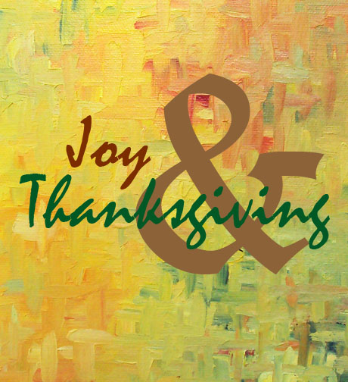
Essentials to grow in the spiritual life #5:
Joy and Thanksgiving
Psalm 118

Slide 2
“Give thanks to the Lord, for he is good; his love endures for ever”
(Psalm 118:1).
Let’s pray…

Slide 3
Psalm 118
Is one of those used when God’s people
meet together in corporate worship.
The psalm skilfully combines the personal element of thanksgiving with the corporate.
This psalm of joyful celebration focuses
on God’s immense goodness

Slide 4
I. The psalmist calls to give to God the glory for His goodness
and ENDURING COMPASSION
¹ Give thanks to the Lord, for he is good; his love endures forever.
² Let Israel say: “His love endures forever.” ³ Let the house of Aaron say: “His love endures forever.” ⁴ Let those who fear the Lord say: “His love endures forever.”

Slide 5
This unchanging truth:
“His love endures forever.”
“For God so loved the world that he gave his one and only Son, that whoever believes in him shall not perish but have eternal life.” John 3:16 (NIV)
But God demonstrates his own love for us in this: While we were still sinners, Christ died for us.
Romans 5:8 (NIV)

Slide 6
II. He preserves an account of God’s gracious dealings
GOD’S TRANSFORMING PRESENCE
⁵ When hard pressed, I cried to the Lord; he brought me into a spacious place. ⁶ The Lord is with me; I will not be afraid. What can mere mortals do to me? ⁷ The Lord is with me; he is my helper. I look in triumph on my enemies.

Slide 7
Hebrews 13:6 (NIV)
So we say with confidence,
“The Lord is my helper; I will not be afraid. What can mere mortals do to me?”

Slide 8
III. David proclaims GOD’S DEPENDABLE POWER.
¹⁰ All the nations surrounded me, but in the name of the Lord I cut them down. ¹¹ They surrounded me on every side, but in the name of the Lord I cut them down. ¹² They swarmed around me like bees, but they were consumed as quickly as burning thorns; in the name of the Lord I cut them down. ¹³ I was pushed back and about to fall, but the Lord helped me.

Slide 9
⁸ It is better to take refuge in the Lord than to trust in humans. ⁹ It is better to take refuge in the Lord than to trust in princes.
¹⁵ Shouts of joy and victory resound in the tents of the righteous: “The Lord’s right hand has done mighty things! ¹⁶ The Lord’s right hand is lifted high; the Lord’s right hand has done mighty things!”

Slide 10
IV. He reminds us of GOD’S LOVING CORRECTION
We are not always at our best
¹⁸ The Lord has chastened me severely, but he has not given me over to death.
Loving discipline is a key element
in our walk with God.

Slide 11
Hebrews 12:5-11 (NIV)
¹¹ No discipline seems pleasant at the time, but painful. Later on, however, it produces a harvest of righteousness and peace for those who have been trained by it.

Slide 12
V. He acknowledges GOD’S PROMISED HELP.
²¹ I will give you thanks, for you answered me; you have become my salvation.

Slide 13
VI. We read about the promised Messiah - GOD’S MATCHLESS SON.
Here David is saying far more than ever he
may have realised
Jesus said to them, “Have you never read in the Scriptures:
“‘The stone the builders rejected has become the cornerstone; the Lord has done this, and it is marvelous in our eyes” Matthew:21:42

Slide 14
“built on the foundation of the apostles and prophets, with Christ Jesus himself as the chief cornerstone.”
Ephesians 2:20 (NIV)

Slide 15
⁶ For in Scripture it says:
“See, I lay a stone in Zion, a chosen and precious cornerstone, and the one who trusts in him will never be put to shame.”
⁷ Now to you who believe, this stone is precious. But to those who do not believe, “The stone the builders rejected has become the cornerstone,” ⁸ and, “A stone that causes people to stumble and a rock that makes them fall.”
They stumble because they disobey the message—which is also what they were destined for.
1 Peter 2 :6-8 (NIV)

Slide 16
²⁸ You are my God, and I will praise you; you are my God, and I will exalt you.
²⁹ Give thanks to the Lord, for he is good; his love endures forever.
Thanksgiving
is an essential dimension of Christian growth.

Slide 17
Essentials to grow in the spiritual life #5:
Joy and Thanksgiving
Psalm 118
In singing this psalm we must glorify God for his goodness, his goodness to us, and especially his goodness to us in Jesus Christ.

