Slide 1
Lessons from Psalms #2:
King David’s description of life
Psalm 23

Slide 2
“The Lord is my shepherd, I lack nothing.”
Psalm 23:1.
Let’s Pray…

Slide 3
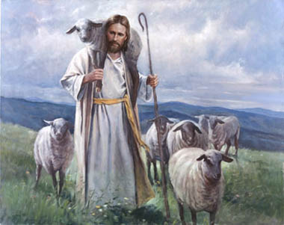
Psalm 23
King David’s description of life

Slide 4
“The Lord is my shepherd, I lack nothing.”
Psalm 23:1.
Verse 1 is about Spiritual needs.
“I lack nothing.”

Slide 5
“He makes me lie down in green pastures, he leads me beside quiet waters,”
Psalm 23:2.
Verse 2 is about GRACE.
David says it is by GRACE.
He has provided everything by GRACE.

Slide 6
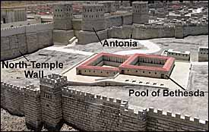
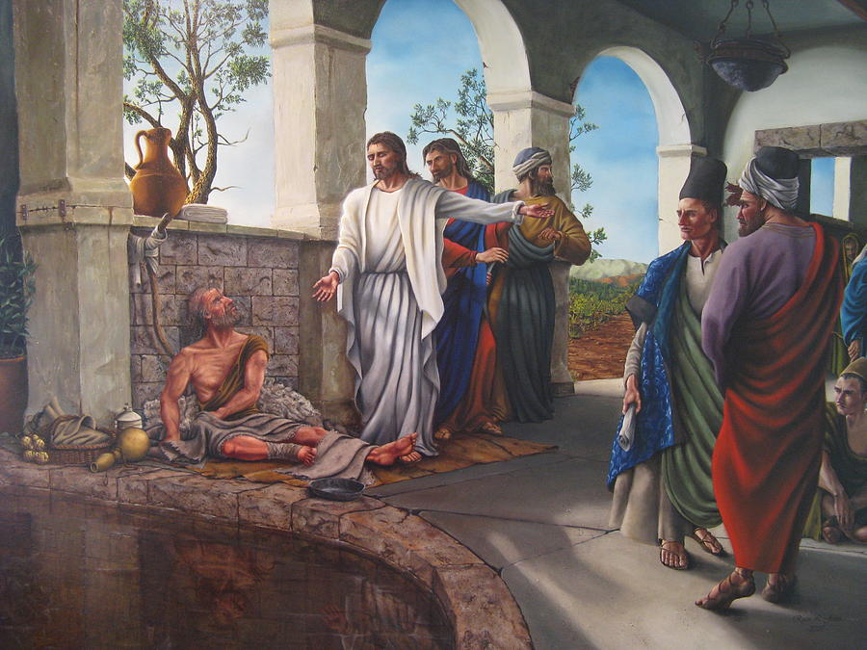
The healing of a lame man at the pool
of Bethesda.
John 5

Slide 7
“He refreshes my soul…”
Psalm 23:3 (NIV)
Verse 3 is about CONVERSION.

Slide 8
The deepest longing of our soul
(although often unconscious)
is for a relationship with the God who made us.
He restores my soul
He renews my life

Slide 9
He refreshes (Restores) my soul.
He guides me along the right paths for his name’s sake.

Slide 10
“Even though I walk through the darkest valley, I will fear no evil, for you are with me; your rod and your staff, they comfort me.”
Psalm 23:4 (NIV)
David is talking about the experience of a believer.

Slide 11
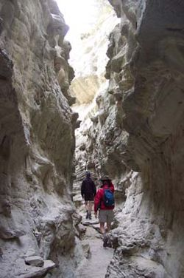
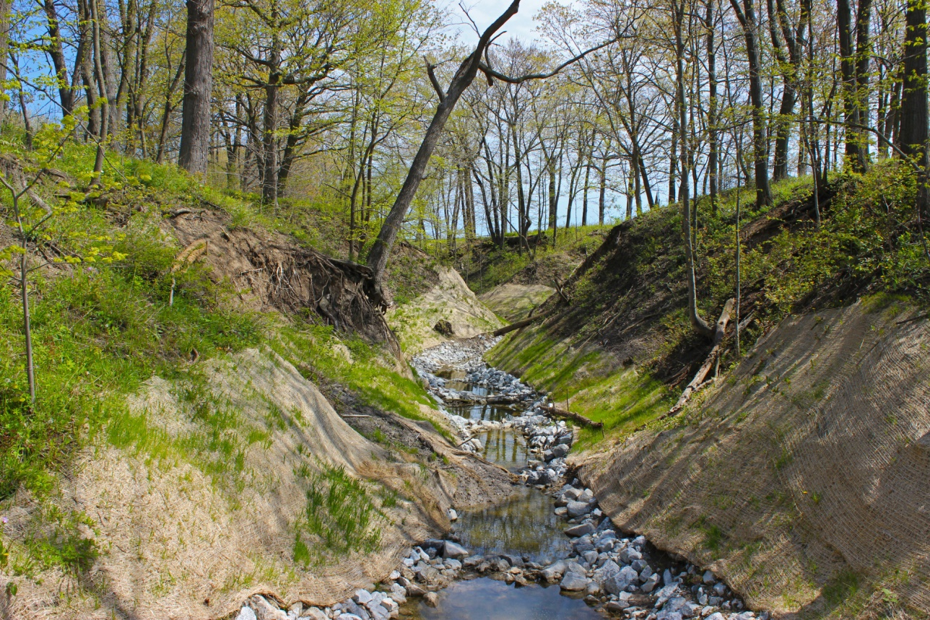
The expression “valley of shadow of death” describes the dangers of life.

Slide 12
“Yet man is born to trouble as surely as sparks fly upward.”
Job 5:7 (NIV)
We are not immune as Christians. We cannot claim “spiritual immunity” from the sorrows and sorrows of life.

Slide 13
You prepare a table before me in the presence of my enemies. You anoint my head with oil; my cup overflows.
Psalm 23:5 (NIV)

Slide 14
“And we know that in all things God works for the good of those who love him, who have been called according to his purpose.”
Romans 8:28 (NIV)

Slide 15
“Surely your goodness and love will follow me all the days of my life, and I will dwell in the house of the Lord forever.”
Psalm 23:6 (NIV)

Slide 16
“Do not let your hearts be troubled. You believe in God; believe also in me. ² My Father’s house has many rooms; if that were not so, would I have told you that I am going there to prepare a place for you?³ And if I go and prepare a place for you, I will come back and take you to be with me that you also may be where I am. ⁴ You know the way to the place where I am going.”
John 14:1-3 (NIV)

Slide 17
Are you burdened with life experiences?
Can you say- The Lord is My Shepherd?

