Slide 1
Lessons from Psalms #19
A prayer for Divine Guidance
Psalm 119:33-40

Slide 2
Let’s Pray…

Slide 3
A prayer for Divine Guidance
I. The Psalmist needs spiritual direction.
“Teach me, LORD, the way of your decrees, that I may follow it to the end”
Psalm 119:33 (NIV)
“I have more insight than all my teachers, for I meditate on your statutes”.
Psalm 119:99 (NIV)

Slide 4
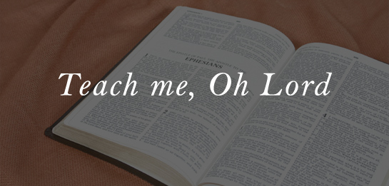
“He who is his own pupil
has a fool for his master.”
SAINT BERNARD

Slide 5
II. The Psalmist needs Spiritual insight,
we need Spiritual insight.
“Give me understanding, so that I may keep your law and obey it with all my heart.”
Psalm 119:34 (NIV)
“The writer is asking for two things that he lacks: understanding and the ability to do what he understands.”
James Montgomery Boice

Slide 6
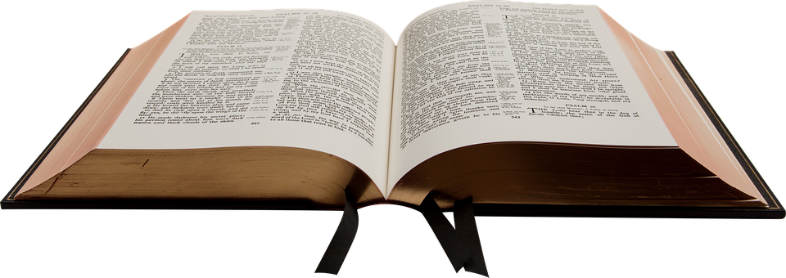
‘Heart’ the word here is the Hebrew word ‘lehv’ which represents the ‘seat of the emotions’ for the Hebrew person. This is often translates as ‘bowels’ to give the picture of a person’s INNERMOST parts!
“Trust in the Lord with all your heart, and do not lean on your own understanding. In all your ways acknowledge him, and he will make straight your paths.”
Proverbs 3:5-6

Slide 7
III. Guidance in the way he walks,
we need direction for the way we walk “OUR FEET”
“Direct me in the path of your commands, for there I find delight”.
Psalm 119:35 (NIV)
The psalmist wanted God to make him obedient.

Slide 8
a) Guidance in the way he feels. (His heart).
“Turn my heart toward your statutes and not toward selfish gain”.
Psalm 119:36 (NIV)
Incline my heart
“to bend toward.”
It is a miracle of grace that takes the love of money from a man and replaces it with a love for the Bible.
William MacDonald

Slide 9
b) Guidance in the way he sees. (His eyes).
“Turn my eyes from looking at worthless things…” Psalm 119:37 (NIV)
“…preserve my life according to your word”.

Slide 10
IV. As the Psalmist walks, he prays for
steadfast perseverance.
a) He prays for Assurance.
“Fulfill your promise to your servant, so that you may be feared.”
Psalm 119:38 (NIV)

Slide 11
b) He prays for Justification.
God's Word Will Make Him Good
“Take away the disgrace I dread,…”
Psalm 119:39 (NIV)

Slide 12
²² Remove from me their scorn and contempt, for I keep your statutes. ²³ Though rulers sit together and slander me, your servant will meditate on your decrees. ²⁴ Your statutes are my delight; they are my counselors.

Slide 13
“When men rail at God’s government of the world it is our duty and privilege to stand up for him, and openly to declare before him, ‘thy judgments are good;’
Charles Spurgeon
“…for your laws are good.”

Slide 14
c) The psalmist prays for Revival.
God's Word will also make him godly.
“How I long for your precepts! In your righteousness preserve my life.”
Psalm 119:40 (NIV)

Slide 15
My dear children, I write this to you so that you will not sin. But if anybody does sin, we have an advocate with the Father—Jesus Christ, the Righteous One.
1 John 2:1 (NIV)
“He is the atoning sacrifice for our sins, and not only for ours but also for the sins of the whole world.” 1 John 2:2 (NIV)

Slide 16
“In your righteousness preserve my life.”

Slide 17
Lessons from Psalms #19
A prayer for Divine Guidance
Psalm 119:33-40

