Slide 1
Matthew 16:24-26 (NIV)
²⁴ Then Jesus said to his disciples, “Whoever wants to be my disciple must deny themselves and take up their cross and follow me. ²⁵ For whoever wants to save their life will lose it, but whoever loses their life for me will find it. ²⁶ What good will it be for someone to gain the whole world, yet forfeit their soul? Or what can anyone give in exchange for their soul?
Then Jesus said to his disciples, “Whoever wants to be my disciple must deny themselves and take up their cross and follow me.

Slide 3
School introduces 'no mornings' policy for tired teenagers
School introduces 1.30pm start for sleepy A-level students
Hampton Court House becomes the first school in the country to allow sixth-formers to start classes in the afternoon to get a lie-in.

Slide 4
If anyone desires to follow Jesus, this is what he/she must do
I. Let him/her deny himself/herself.
First, The Disciple is Called to Lay Something Down – Deny Himself
"If anyone desires to come after Me, let him deny himself…”
The phrase “deny himself” literally means, “to completely disown, to utterly separate oneself from someone.”

Slide 5
1 Corinthians 13:3 (NIV)
“If I give all I possess to the poor and give over my body to hardship that I may boast, but do not have love, I gain nothing.”
We are to count the old man as being dead, (Rom. 6:11).
To deny oneself means to follow the example set forth by the Lord Jesus Himself in coming to this world. (Phil. 2:5-8).
The phrase “deny himself” literally means, “to completely disown, to utterly separate oneself from someone.”

Slide 6
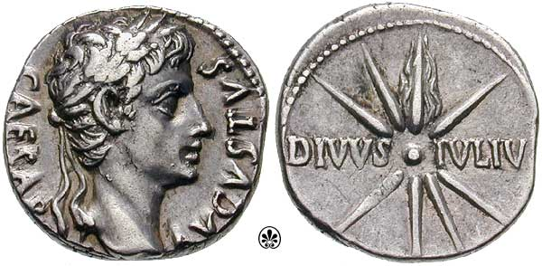
Matthew 22:19-21 (NIV)
¹⁹ Here, show me the coin used for the tax.” When they handed him a Roman coin, ²⁰ he asked, “Whose picture and title are stamped on it?”
²¹ “Caesar’s,” they replied. “Well, then,” he said, “give to Caesar what belongs to Caesar, and give to God what belongs to God.”

Slide 7
If anyone desires to follow Jesus, this is what he/she must do
II. Let him/her take up his/her cross.
Secondly, The Disciple Is Called To Lift Something Up – Take Up His Cross –
"If anyone desires to come after Me … let him … take up his cross…”
The cross is not just a place of suffering,
it is a place of death!

Slide 8
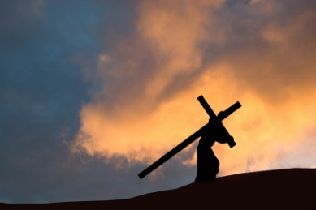
II. Let him take up his cross.
When Jesus says that we are to take up our cross, He is saying that we are to live as dead men or women.
"Walk down death row daily and follow Me."

Slide 9
If anyone desires to follow Jesus, this is what he/she must do
III. Let him/her follow me.
Third, The Disciple Is Called To Live Something Out – Follow Me - "If anyone desires to come after Me …., let him … follow Me.”
Here Jesus says, literally “let him follow me day by day.”
a) He has gone ahead
b) He has showed us the way
c) He has carried a heavy cross

Slide 10
If anyone desires to follow Jesus, this is what he/she must do
I. Let him deny himself.
II. Let him take up his cross.
III. Let him/her follow me.

Slide 11
²³ Let us hold unswervingly to the hope we profess, for he who promised is faithful. ²⁴ And let us consider how we may spur one another on toward love and good deeds, ²⁵ not giving up meeting together, as some are in the habit of doing, but encouraging one another—and all the more as you see the Day approaching.
Hebrews 10:23-25 (NIV)
Then Jesus said to his disciples, “Whoever wants to be my disciple must deny themselves and take up their cross and follow me.

